Slide 1
Data Analytics
by
Dr Lalit Prasad

Slide 2
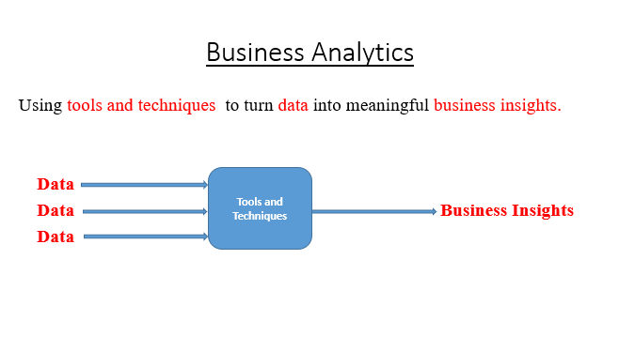
Business Analytics

Slide 3
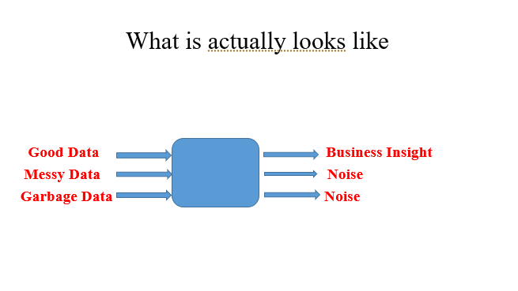
Business Analytics
Tools and Techniques

Slide 4
A Note about Buzz Words..
There are lots of Buzz words that closely resemble business analytics.
Business Intelligence
Data Science
Decision Science

Slide 5
Challenges..
Data often needs lots of cleaning!
This can be sometimes the most frustrating task.
Data is rarely is in the form that you need it.

Slide 6
Challenges..
Data is much more unstructured !
It does not all come from relational databases or spreadsheets, pdf, mp3, jpg, Xls, doc, etc

Slide 7
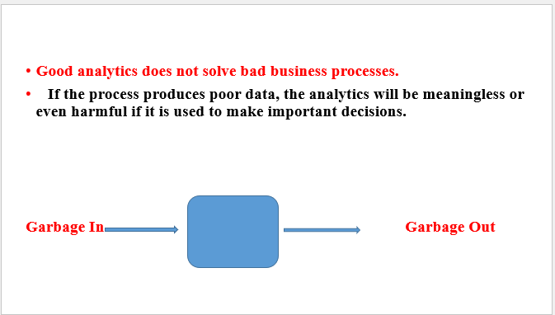
Challenges..

Slide 8
Steps involved in Data Analytics/Business Analytics
a) Decide on the objectives: In your data analysis process, you must begin with the right set of questions. Some examples include: How can we reduce production costs without sacrificing quality? What are some ways to increase sales opportunities with our current resources? Do customers view our brand in a favorable way? etc.
b) Set measurement priorities: This step involves processes to identify what to measure and how to measure? For example, should you perform your analysis weekly, monthly or annually? What is your unit of measure? What factors should be included in your analysis? etc.

Slide 9
Continued..
Data collection: Data Collection is the process of collecting information on targeted variables for your analysis. In this step, the emphasis is to ensure collecting accurate and honest data. Thus, before you start your hunt for collecting new data, find what information could be collected from existing data sources.
Data cleaning: Data Cleaning is the process of preventing and correcting errors in data. It includes steps such as structuring the data as required for the relevant analysis tools, removing duplicate values, identifying outliers in data, etc

Slide 10
Continued..
Analysis of data: Various data analysis techniques can be used to understand, interpret, and derive conclusions based on the requirements. . Tools like Microsoft Excel, R, Python, Tableau, etc. can be used for performing analysis.
Interpreting the results: Does the analysis answer your objectives? Does the analysis help you defend against any objections? Is there any limitation on your conclusions, any angles you haven’t considered? If your interpretation of the data holds up, under all of these questions and considerations, then you likely have come to a productive conclusion. Create a report of your analysis in a format as required by stakeholders for business decisions. The feedback from stakeholders might result in additional analysis

Slide 11
Hiring trends in Data Science
In August 2020, India contributed to 9.8% of the total global Analytics job openings. This is a significant jump from the figure of 7.2% of total global job openings in January 2020.
Almost 98% (97.8%) of Analytics jobs advertised in India are full-time, signifying the strengthening of the Indian Analytics hiring market.
Just 2% of the jobs form part-time, internship or contractual jobs – similar to the trend of January 2020 and the overall trend of 2019, when an approximate 97.5% full-time and 2.5% part-time jobs were advertised.

Slide 12
Continued..
The Banking sector was one of the early adopters of analytics across operations. This sector continues to be the biggest influencer in the analytics job market with 35% of all Analytics jobs. Other sectors contributing to analytics job market in India significantly are, Pharma and Healthcare Industry, e-commerce, energy & utilities.

Slide 13
Continued..
In terms of cities, Bengaluru once again accounts for the maximum proportion of open jobs, contributing around 23% of Analytics jobs in India.
Delhi/ NCR comes second contributing 20% of the analytics jobs in India, down from 21% in January 2020, and from 22% a year ago. Approximately 15% of the Analytics jobs are advertised for Mumbai. This is a marginal increase from 14% in January 2020 and a marginal decrease from 14.7% last year.

Slide 14
Continued..
The demand for Python professionals continues to remain the highest. Almost 27% of advertised jobs require Python as a core skill, which was 18.5% at the beginning of the year 2020. R comes third with 10% of all analytics jobs requiring R as a core skill.
The median salary advertised across Analytics jobs in India is 9.5 Lakhs per annum. 13.1% of all advertised jobs in August 2020 offer a salary greater than 15 Lakhs per annum. Close to 10% of all advertised jobs in August 2020 offer a salary between 15 to 25 Lakhs per annum.

Slide 15
Data Analysis and Visualization Tools
Tools | Types of Analytics
 | Descriptive What happened? | Diagnostic Why did it happen? | Predictive What will happen? | Prescriptive How can we make it happen? Best Solution
Typical Statistical Procedures or Calculations | Central Tendency: Averages/Means Median Mode The Measure of Dispersion: Range, Mean Deviation, Quartile Deviation, Standard Deviations Counts Ratio Trends etc | T-tests ANOVAs Correlation Regression Cross Tabulation and Chi-Square Factor Analysis Correspondence Analysis etc | Regression- Linear, Curvilinear, Logistic, and Ridge Partial Least Squares Discriminant Analysis Decision Tree Random Forests Naïve Bayes etc | Operations Research and Mathematical Models (LPP etc.)
Typical Visualization | Histograms Pie-Charts Line Charts Area Charts Frequency Distributions etc | Scattergrams Regression Plots Plots of Residuals Box Plots Multiple Density Curves Balloon Plots Mosaic Plots etc | Numeric Information Line Charts Scattergrams/Correlation Plots Categorical Information Decision Trees ROC Curves AUC Curves Confusion Matrix

Slide 16
When to use which statistical Test ?
Tests | Factor Variable/Independent Variable /predictor | Response Variable/Dependent Variable/ Criterion | Sample(s) | Application
One sample t- test | Metric (Test Value) | Metric (Interval and Ratio) | One Sample | Compare Means
Independent Sample t-test | Non-Metric | Metric | Two Independent Samples | Compare Means
Paired t-test | Metric | Metric | Related sample (Before and After) | Compare Means
Chi-Square | Non-Metric | Non-Metric | One sample, Two or More sample | Test of Independence & Goodness of fit

Slide 17
Summary : ANOVA Family
IV= Independent Variable, DV=Dependent Variable |  | DV=1 | DV>=2
 |  | Metric | Metric
IV=1 | Nonmetric | One Way ANOVA | One Way MANOVA
IV=2 | Both Nonmetric | Two-way ANOVA | Two Way MANOVA
 | Mixed-one Metric(Covaraite) & one Non-metric | One Way ANCOVA | One Way MANCOVA
IV=3 | All Nonmetric | N-Way ANOVA | N-Way MANOVA
 | Mixed -Two Non-metric & one Metric | Two-way ANCOVA | Two-way MANCOVA

Slide 18
Tests | Factor Variable(s)/Independent Variable (s)/predictors | Response Variable(s)/Dependent Variable/(s) Criterion | Application
Correlation | Metric | Metric | Strength of Relationship & Direction of Relationship
Regression: Simple and Multiple | Metric | Metric | Impact of Independent variable(s) on Dependent Variable
Multiple Regression Using Dummy | Mixed or categorical | Metric | --- Do----
Hierarchical Regression | Metric or Mixed | Metric | Impact of Independent variable on Dependent Variable- Best Model
Logistic Regression | Non-Metric or Metric or Mixed | Non -Metric | Impact of Independent variable on Dependent Variable and Classification

Slide 19
Tests | Factor Variable/Independent Variable /predictor | Response Variable/Dependent Variable/ Criterion | Sample(s) | Application
Discriminant Analysis | Metric | Non -Metric | ---- | Impact of Independent variable on Dependent Variable
Correspondence analysis | Non- Metric ( Nominal with two category ) |  | ---- | Association
Multidimensional Scaling | Ordinal, Interval and Ratio |  | ---- | Association
Canonical Correlation | Metric | Metric | ----- | Relationship between two variates
Conjoint Analysis | Metric or Mixed or non-metric | Metric | ----- | Find values of different stumli

Slide 20
Tests | Scale | Comments
Factor Analysis | Metric Scale | Data Reduction or Dimension reduction or reduction of variables into factors
Cluster Analysis | Metric Scale or Nonmetric | Segmentation
Confirmatory Factor Analysis (Measurement Model) | Metric | Validity
Structured Equation Modeling(SEM) using SPSS and AMOS | Metric | SEM is somewhat like performing many linear regressions at the same time, along with each of the variables in the regression also being tested as a factor analysis . Multiple tests done simultaneously add their own value to understanding the larger picture.

Slide 21
Thank You

